Slide 1

Computer Science
Performance Analysis and Simulation course
Winter Wheat
Growth Cycle

Slide 2
Introduction
Project Domain & Objective

Slide 3
1
Seeding
2
Germination
Winter Wheat
Growth Cycle
Stages
3
Tillering
The winter wheat growth cycle consists of multiple phases influenced by various factors
4
Flowering
5
Ripening

Slide 4
OBJECTIVE
The objective of this project is to develop a population model for the growth cycle of winter wheat and to conduct simulations to observe and study its behavior under different conditions, providing valuable information on its dynamics.

Slide 5
Population Model
Species, Influencing Factors and Rules

Slide 6
SPECIES
ROTTEN
SEED
PLANT
FLOWER
SEED
TILLER
KERNEL
Wheat Seeds
The species from which the growth cycle begins
Rotten Seeds
Seeds that rot due to lack of nutrients in the soil
Wheat Plants
Seeds that germinate will produce a plant that then grows
Tillers
They are distinct small branches of the plant that develop flowers
Flowers
They are responsible for producing the kernels of wheat
Wheat Kernels
They represent the final results of the winter wheat growth cycle

Slide 7
INFLUENCING FACTORS
Daily Water
Daily Water
Daily Water
Soil Nutrients
Daily Water
Temperature
Fertilizer
The percentage of nutrients in the soil
The average daily water received by the plantation during its growth period
The average daily temperature during the growth cycle period
The average amount of fertilizer applied per plant

Slide 8
RULES
1
Seed produces plant
S -[soil_nutrients]-> P
2
Seed rots
S -[1-soil_nutrients]-> RS
3
Plant produce tillers
P[i] -[environmental_conditions]-> T | P[i-1]
4
Tiller produce flower
T[i] -[soil_nutrients * environmental_conditions * productive_tillers_rate]-> F | T[i-1]
5
Flower produce kernels
F[i] -[fertilization_rate * environmental_conditions]-> K | F[i-1]

Slide 9
Simulations Overview
A closer look at four separate case studies

Slide 10
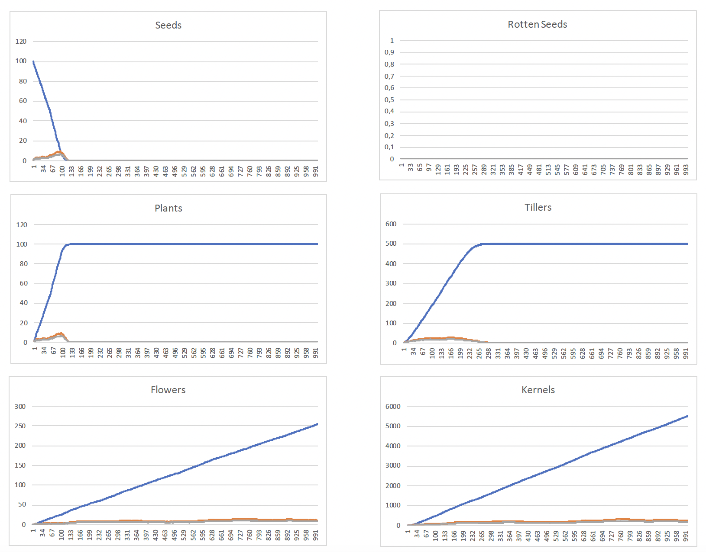
Case Study 1
Best Overall Conditions
Parameters
soil_nutrients = 1;
daily_water = 5;
temperature = 15;
fertilizer = 2;
Initial State
S<100>;

Slide 11
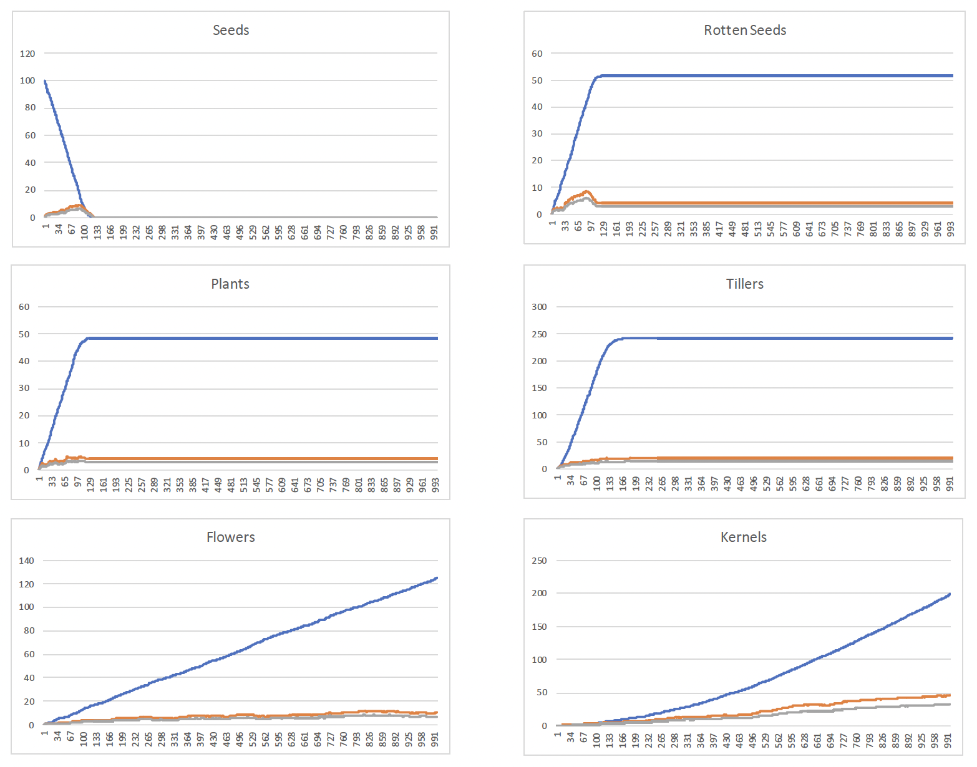
Case Study 2
Low Soil Nutrients
Parameters
soil_nutrients = 0.5;
daily_water = 5;
temperature = 15;
fertilizer = 2;
Initial State
S<100>;

Slide 12
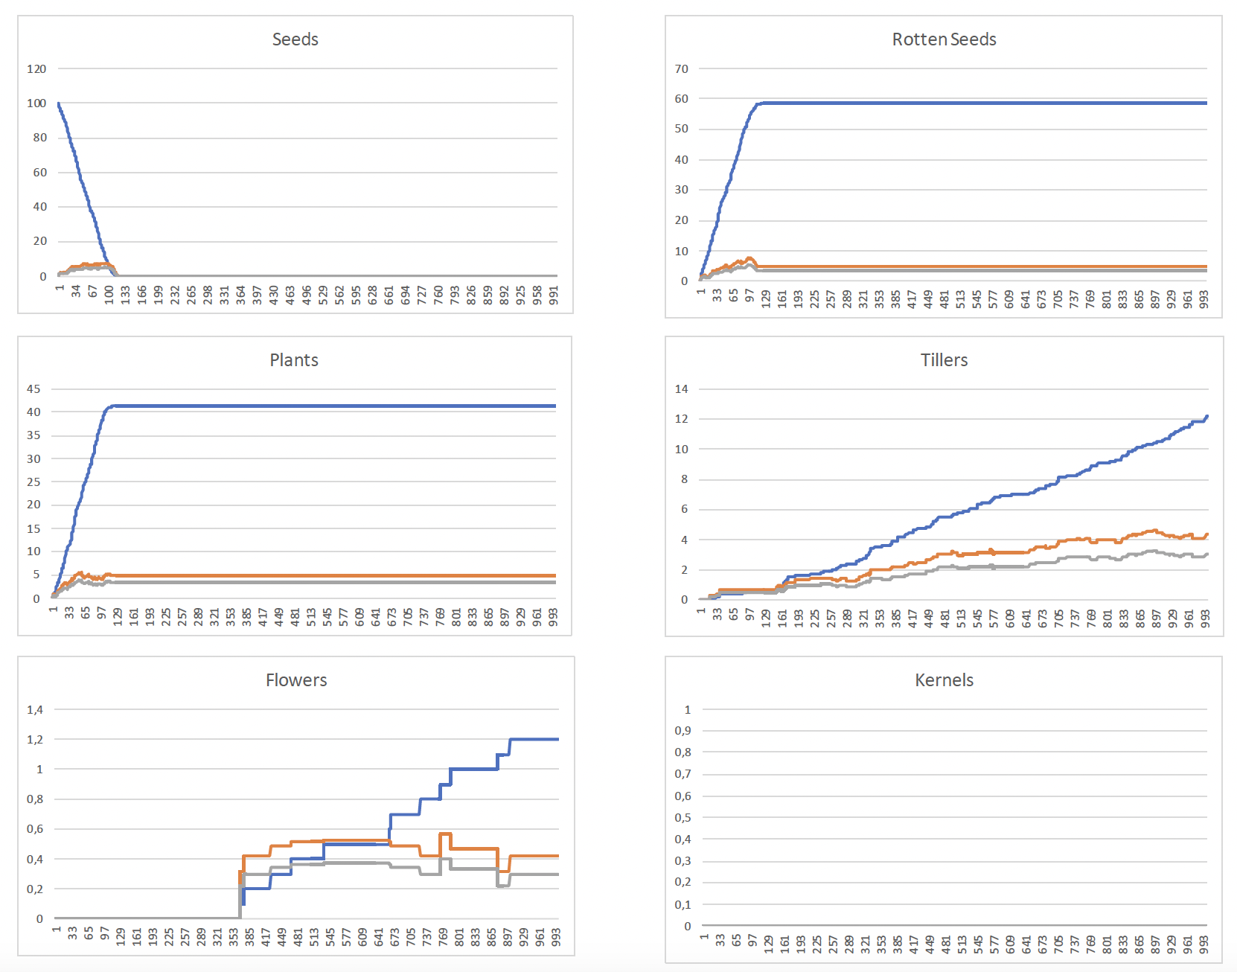
Case Study 3
Dry Weather Conditions
Parameters
soil_nutrients = 0.4;
daily_water = 2.5;
temperature = 30;
fertilizer = 2;
Initial State
S<100>;

Slide 13
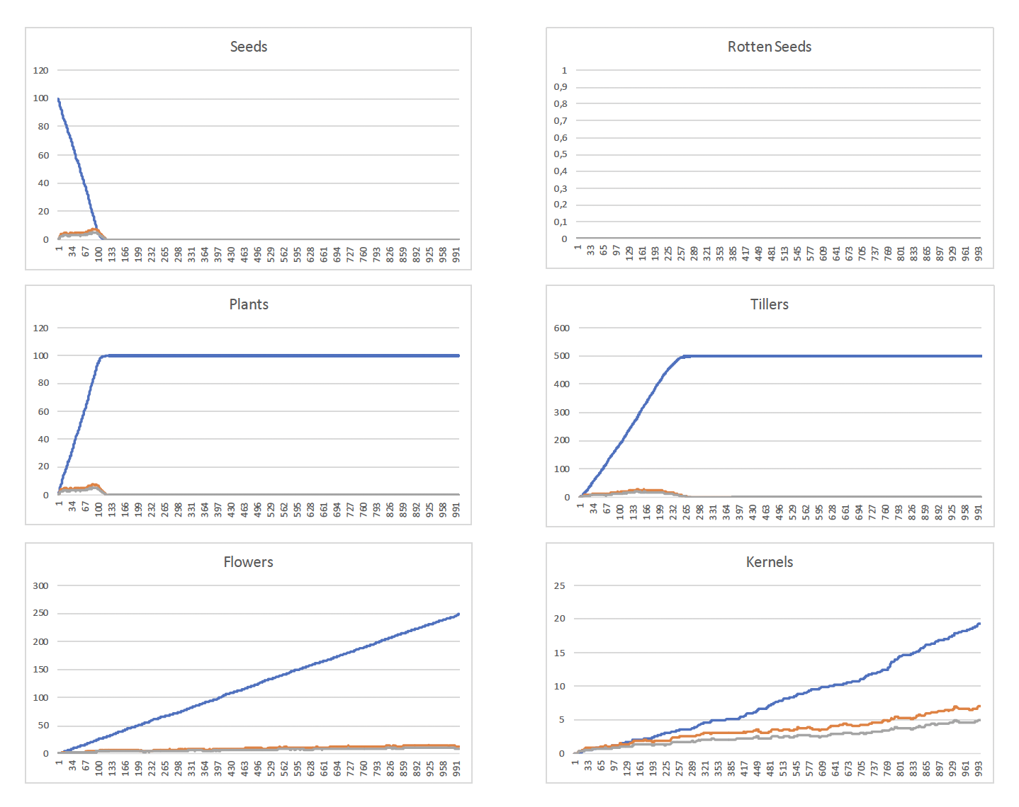
Case Study 4
Too Much Fertilizer
Parameters
soil_nutrients = 1;
daily_water = 5;
temperature = 15;
fertilizer = 5;
Initial State
S<100>;

Slide 14

Thanks for your attention!
Presented by
Roberto Cesetti
roberto.cesetti@studenti.unicam.it

